Slide 1
Deep Learning
Avanade ASG Data Science Bootcamp

Slide 2
Introduction

Slide 3
What is Deep Learning?
Deep learning is a subfield of Machine Learning that comprises learning from data with deep artificial neural networks.
Artificial neural networks are inspired by the human brain, and they are the most promising shot to general artificial intelligence as of today (although we are still far away from general artificial intelligence).
The state-of-the-art models in many domains / for many data structures are deep-learning-based:
For sequence data / natural language processing: GPT-3, BERT, …
For grid data / computer vision: ViT, StyleGAN-XL, …
For graph data: GCN, GAT, …
Not for tabular data though, where XGBoost still reigns!
Artificial Intelligence
Machine Learning
Deep Learning

Slide 4
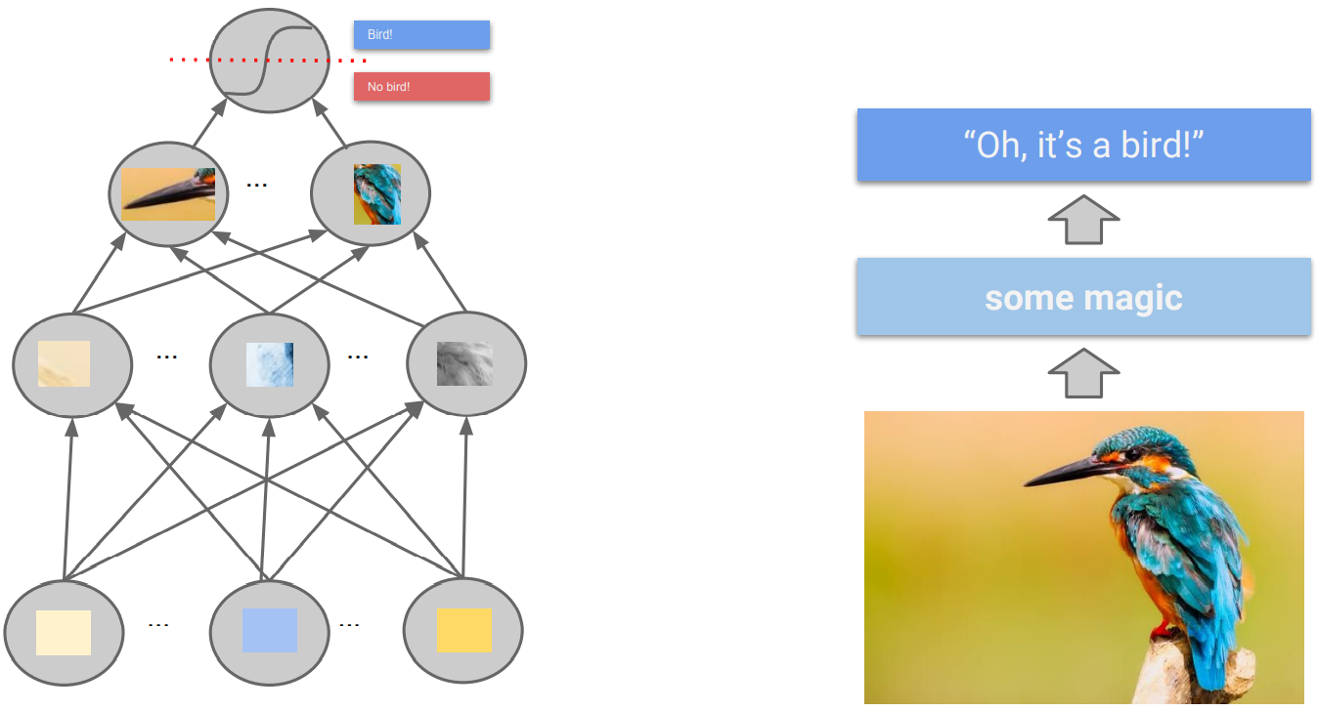
(Artificial) Neural Network Intuition
“Machine learning algorithms, inspired by the brain, based on learning multiple levels of representation / abstraction.” (Yoshua Bengio)

Slide 5
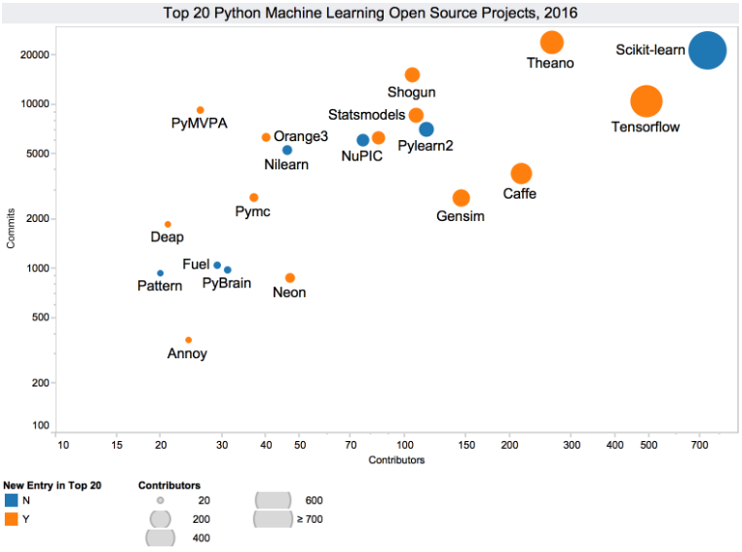
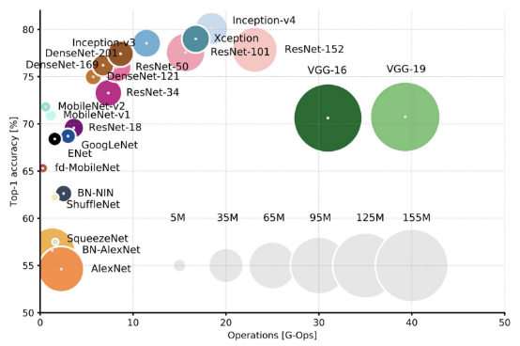
History & Present of (Deep) Neural Networks
Deep learning is not new. Artificial neural networks have been first proposed in 1943. Deep neural networks, i.e. artificial neural networks with multiple hidden layers have been around since the 1970s. They were semi successful.
But deep learning has taken off since the start of this millennium. Why is that?
Specialized, powerful hardware (GPUs, TPUs) allows training of huge neural networks to push the state-of-the-art performance on difficult problems.
Large amount of data is available because of increasing digitalization: Web 2.0, IoT, modern ERP & CRM systems etc.
Special network architectures have been designed by researchers for image / text / graph data.
Better optimization and regularization strategies have been developed.
Distributed frameworks allow for parallel training.
Open-source culture in the AI community drives further progress.
Cloud platforms like Azure, AWS, GCP make training of large-scale deep learning models more accessible.

Slide 6
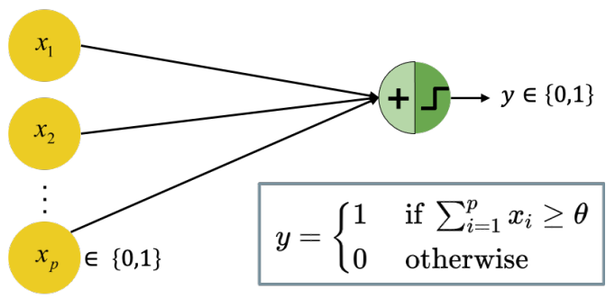
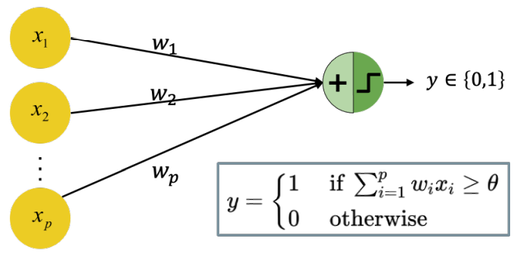
A Brief History: Starting from the Beginning
1943: the first artificial neuron, the “Threshold Logic Unit (TLU)”, was proposed by Warren McCulloch & Walter Pitts
The model is limited to binary inputs
It fires/outputs +1 if the input exceeds a certain threshold θ
The weights are not adjustable, so learning could only be achieved by changing the threshold θ
1957: the perceptron was invented by Frank Rosenblatt
The inputs are not restricted to be binary
The weights are adjustable and can be learned by learning algorithms
As for the TLU, the threshold is adjustable based on the classification result and decision boundaries are linear

Slide 7
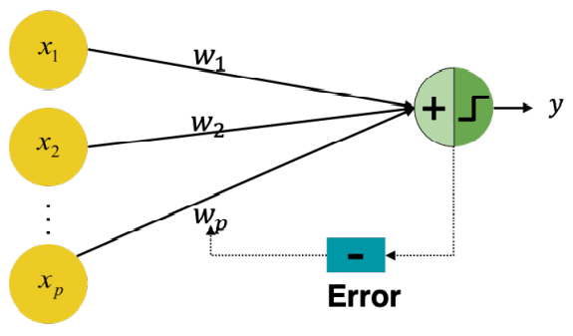
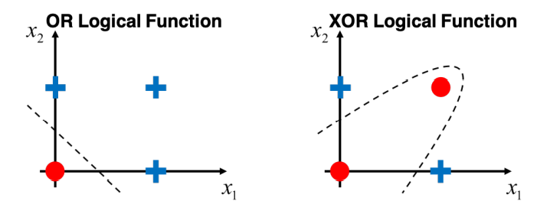
A Brief History: First AI Winter
1960: Adaptive Linear Neuron (ADALINE) was invented by Bernard Widrow & Ted Hoff; weights are now adjustable according to the weighted sum of inputs instead of just classification result
1965: group method of data handling (also known as polynomial neural networks) by Alexey Ivakhnenko. The first learning algorithms for supervised deep feedforward multilayer perceptrons.
1969: the first “AI Winter” kicked in.
Marvin Minsky & Seymour Papert proved that a perceptron cannot solve the XOR-Problem (linear separability)
Less funding led to standstill in AI/DL research

Slide 8
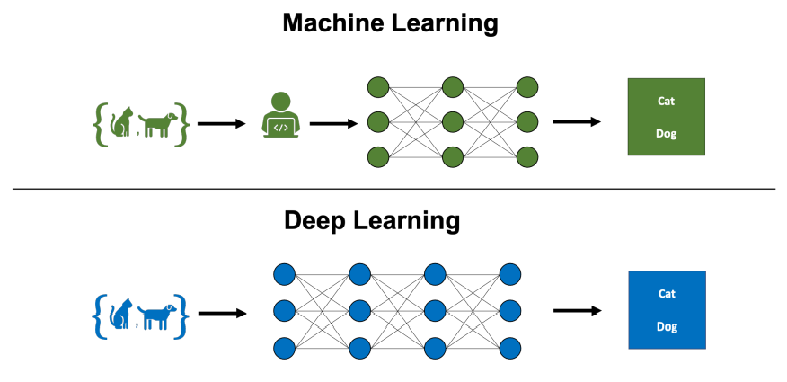
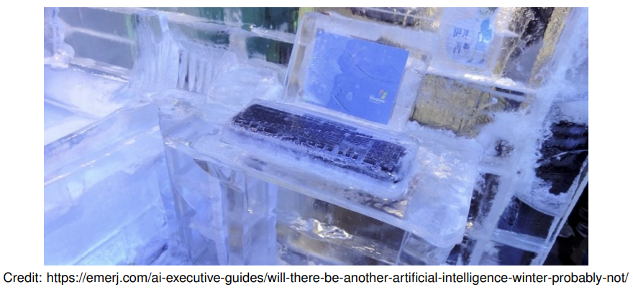
A Brief History: Second AI Winter
1985: Multilayer perceptron with backpropagation by David Rumelhart, Geoffrey Hinton, and Ronald Williams
Efficiently compute derivatives of composite functions
Backpropagation was developed already in 1970 by Linnainmaa
1985: the second “AI Winter” kicked in.
Overly optimistic expectations concerning potential of AI/DL
The phrase “AI” even reached a pseudoscience status
Kernel machines and graphical models both achieved good results on many important tasks
Some fundamental mathematical difficulties in modeling long sequences were identified.
2006: age of deep neural networks began
Geoffrey Hinton showed that a deep belief network could be efficiently trained using greedy layer-wise pretraining.
This wave of research popularized the use of the term deep learning to emphasize that researchers were now able to train deeper neural networks than had been possible before.
At this time, deep neural networks outperformed competing AI systems based on other ML technologies as well as hand-designed functionality.

Slide 9
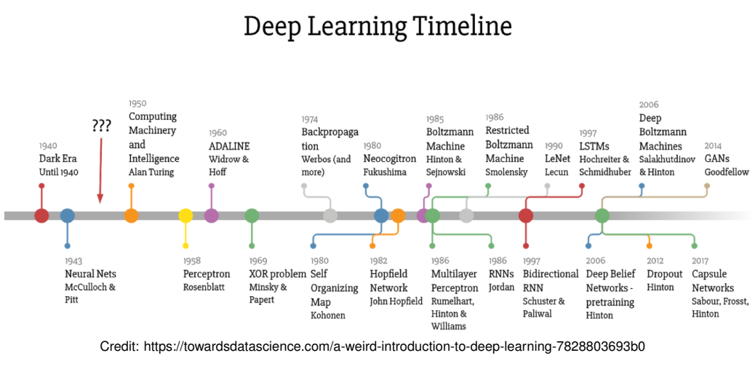
A Brief History: Timeline of Algorithms
2017: Transformers!!!

Slide 10
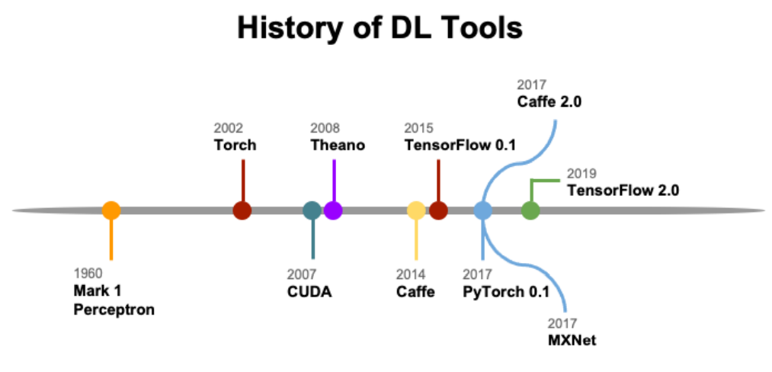
A Brief History: Timeline of Tools
2018: JAX

Slide 11
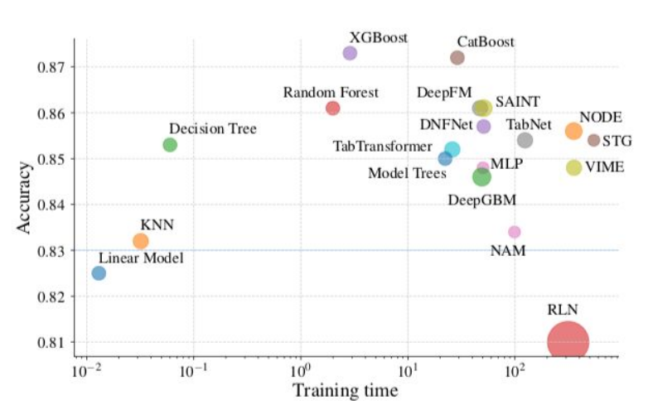
When is Deep Learning Useful? (1/3)
Deep learning can be extremely valuable if the data has these properties:
It is high dimensional.
Each single feature itself is not very informative but only a combination of them is.
Large amounts of training data are available.
For tabular data, deep learning is therefore rarely the correct model choice.
Without extensive tuning, models like random forests or gradient boosting will outperform deep learning most of the time.
Borisov, V. et al. Deep neural networks and tabular data: A survey. arXiv [cs.LG] (2021)
One exception is data with categorical features with many levels.

Slide 12
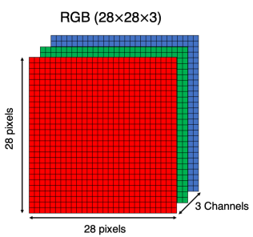
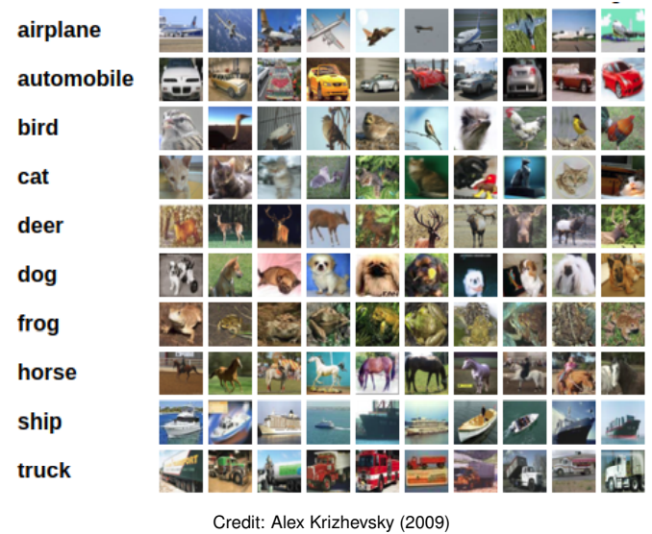
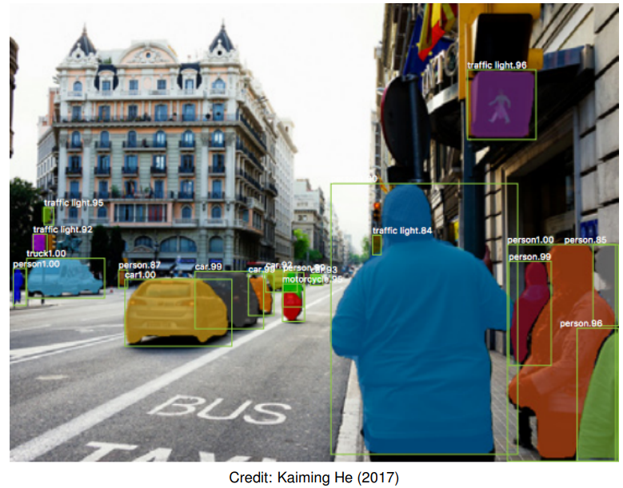
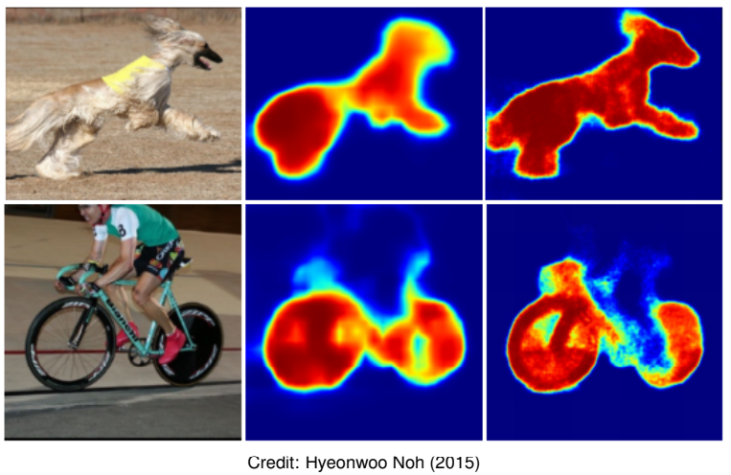
When is Deep Learning Useful? (2/3)
One promising use case for deep learning are tasks based on images as they are characterized by:
High dimensionality: a color image with 255 × 255 (3 Colors) pixels already has 195075 features.
Informativeness: a single pixel is not meaningful but only a combination of pixels is.
Training data: depending on the desired application, huge amounts of data are available.
Traditionally, Convolutional Neural Networks (CNNs) were the architecture of choice for tasks involving images. Now transformer-based architectures are taking off. Possible tasks include but are not limited to:
Image classification: predict a single label for each image
Object detection: generate bounding boxes for each instance
Instance segmentation: partition the image into segments

Slide 13
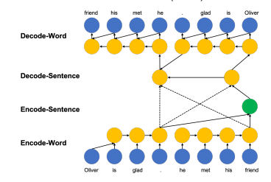
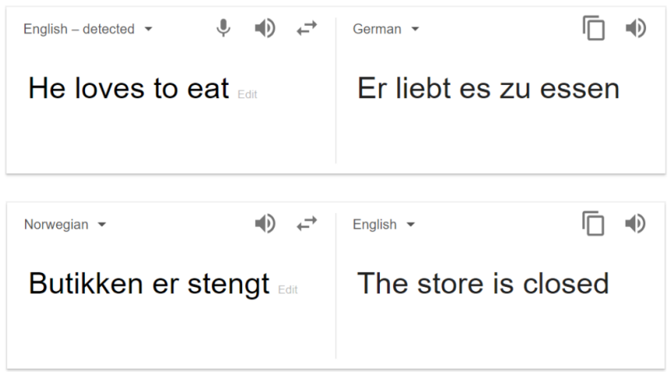
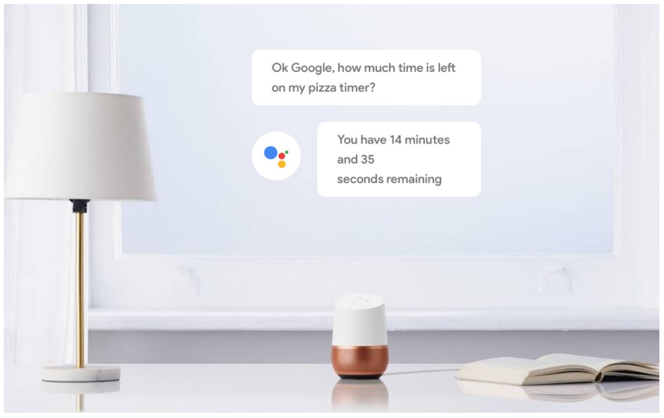

When is Deep Learning Useful? (3/3)
Another promising use case for deep learning are tasks based on text as it is characterized by:
High dimensionality: each word can be a single feature (300,000 words in German).
Informativeness: a single word does not provide much context.
Training data: huge amounts of text data available.
Traditionally, Recurrent Neural Networks (RNNs) and Long short-term memory (LSTM) were the architectures of choice for tasks involving text. Now transformer-based architectures are the unattainable state-of-the-art. Possible tasks include but are not limited to:
Sentiment analysis: systematically identify the emotional and subjective information in texts
Machine translation: predict likelihood of a sequence of words, typically modeling entire sentences in a single integrated model
Speech recognition & generation: Extract features from audio data for downstream tasks, e.g. to classify emotions in speech

Slide 14
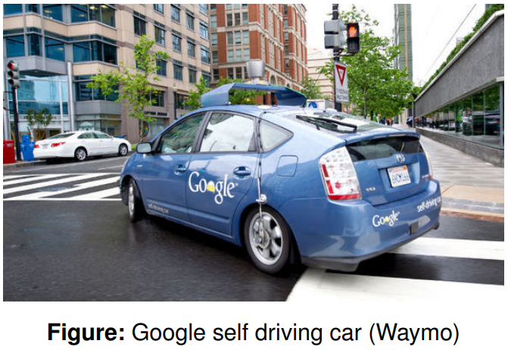
Deep Learning Breakthrough Applications
Google’s development of self-driving technology began on January 17, 2009, at the company’s secretive X lab.
By January 2020, 20 million miles of self-driving on public roads had been completed by Waymo.

Slide 15
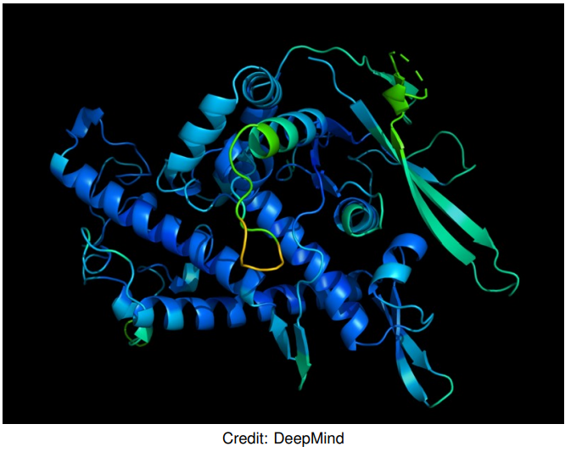
Neural Network Breakthrough Applications
AlphaFold is a deep learning system, developed by Google DeepMind, for determining a protein’s 3D shape from its amino-acid sequence.
In 2018 and 2020, AlphaFold placed first in the overall rankings of the Critical Assessment of Techniques for Protein Structure Prediction (CASP).

Slide 16
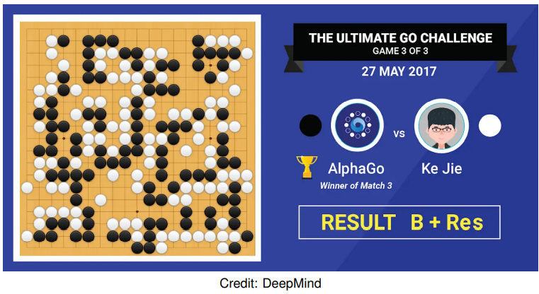
Neural Network Breakthrough Applications
AlphaGo, originally developed by DeepMind, is a deep learning system that plays the board game Go. In 2017, the Master version of AlphaGo beat Ke Jie, the number one ranked player in the world at the time.
While there are several extensions to AlphaGo (e.g., Master AlphaGo, AlphaGo Zero, AlphaZero, and MuZero), the main idea is the same: search for optimal moves based on knowledge acquired by machine learning.

Slide 17

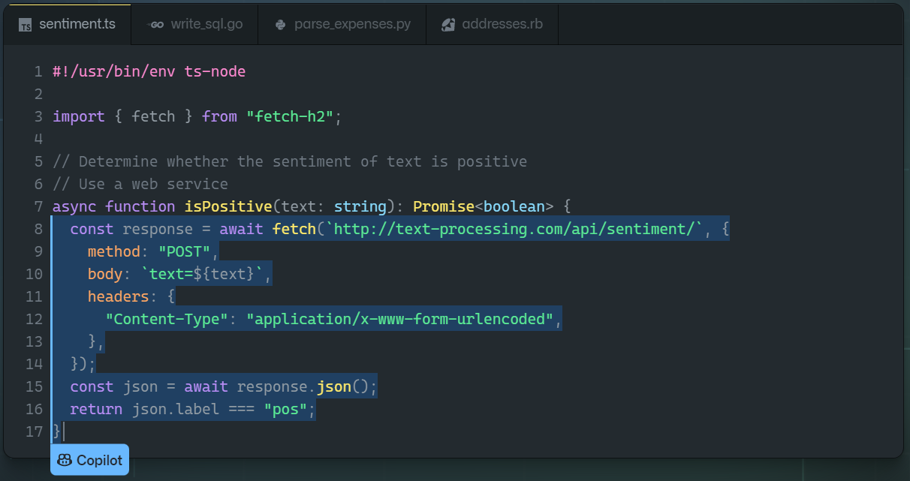
Breakthrough Applications: GitHub Copilot
GitHub Copilot is a code assistant powered by Codex, a new AI system created by OpenAI. GitHub Copilot uses the context you’ve provided and synthesizes code to match.
Find more information here: GitHub Copilot · Your AI pair programmer.

Slide 18
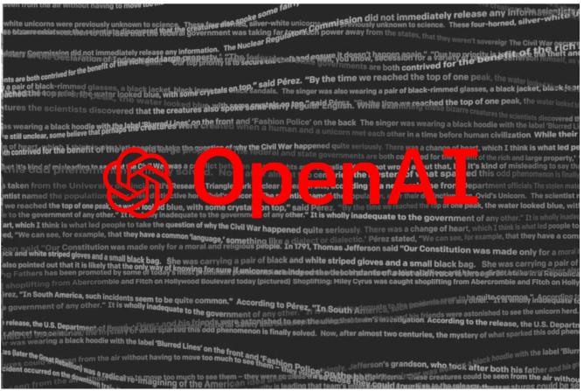
Neural Network Breakthrough Applications
Generative Pre-trained Transformer 3 (GPT-3) is the third generatation of the GPT model, introduced by OpenAI in May 2020, to produce human-like text.
There are 175 billion parameters to be learned by the algorithm, but the quality of the generated text is so high that it is hardly possible to distinguish it from a human-written text.

Slide 19

Neural Network Breakthrough Applications
Dall-E-2 is a new AI system from January 2021 that can create realistic images and art from a description in natural language
DALL·E 2 (openai.com)

Slide 20
Neural Network Basics

Slide 21
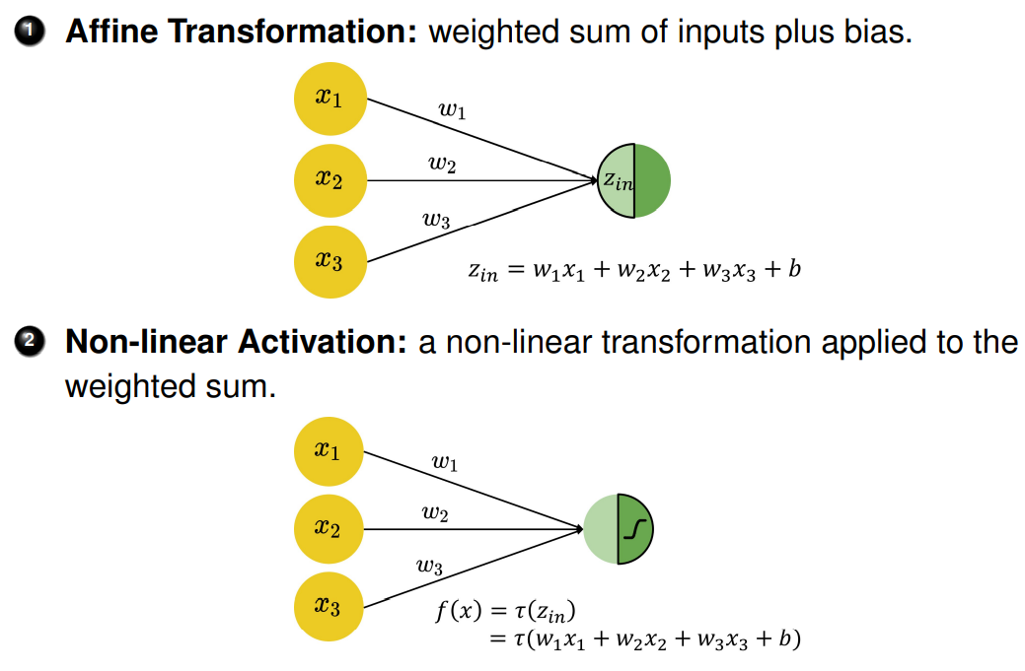
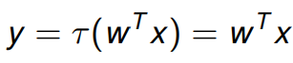
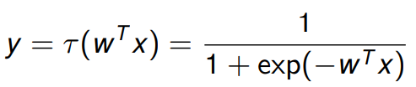
Fully-Connected Neural Networks
The basic computational unit for neural networks is the perceptron. It is a weighted sum of input values plus bias term, transformed by a non-linear activation function, resulting in an output value (→ single neuron).
A suitable choice of the activation function τ leads to known functions f(x).
The identity function gives us the simple linear regression:
The logistic function (sigmoid function) gives us the logistic regression:
Notes:
Single-layer network with sigmoid activation function could approximate any continuous function infinitely closely (Universal Approximation Theorem)

Slide 22
Fully-Connected Neural Networks
The basic computational unit for neural networks is the perceptron. It is a weighted sum of input values plus bias term, transformed by a non-linear activation function, resulting in an output value (→ single neuron).
A suitable choice of the activation function τ leads to known functions f(x).
The identity function gives us the simple linear regression:
The logistic function (sigmoid function) gives us the logistic regression:

Slide 23
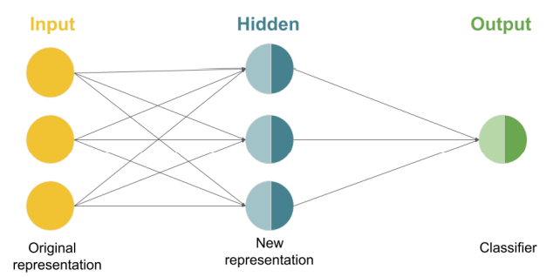
Fully-Connected Neural Networks
The basic computational unit for neural networks is the perceptron. It is a weighted sum of input values plus bias term, transformed by a non-linear activation function, resulting in an output value (→ single neuron).
A suitable choice of the activation function τ leads to known functions f(x).
The identity function gives us the simple linear regression:
The logistic function (sigmoid function) gives us the logistic regression:
A neural network is “just” a mathematical function f(x) that maps inputs to outputs (no magic involved). But the function f(x) can be complex. It is defined through the neural network architecture.
Fully-connected neural networks are also known as plain/vanilla neural networks or multilayer perceptrons and describe the simplest neural network architecture where all neurons from one layer are connected to the neurons of the next layer.
Fully-connected neural networks can approximate any continuous function, including simple “traditional” machine learning models such as linear and logistic regression (for the two latter a single perceptron/neuron suffices) .

Slide 24
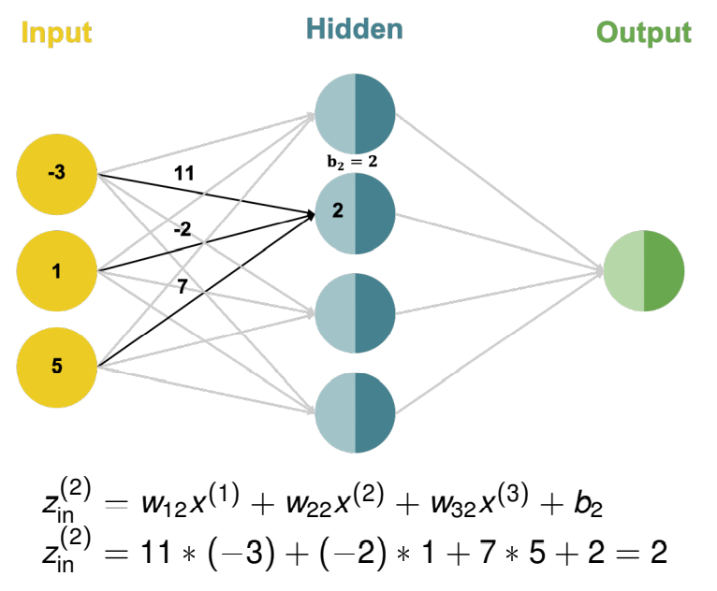
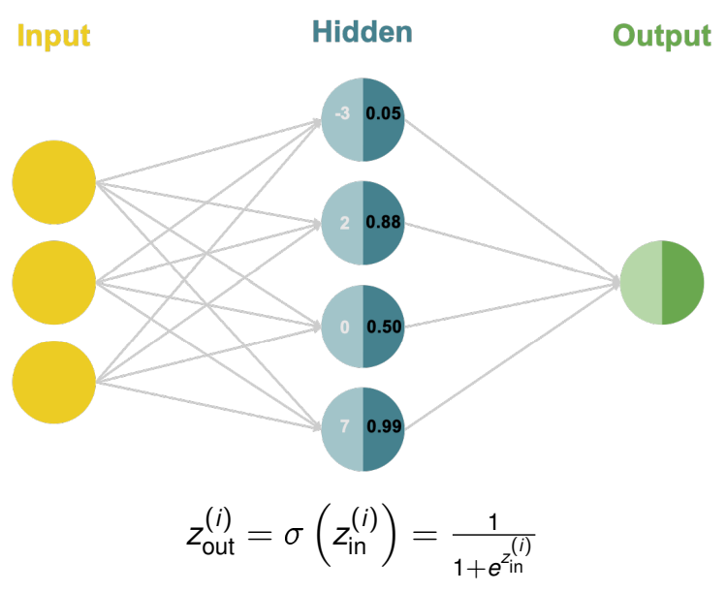
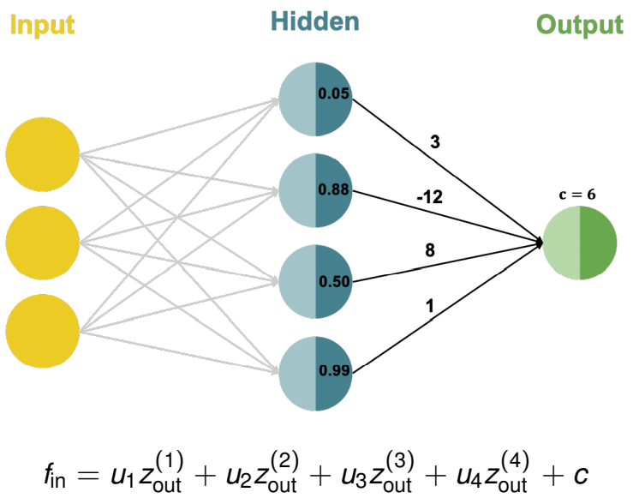
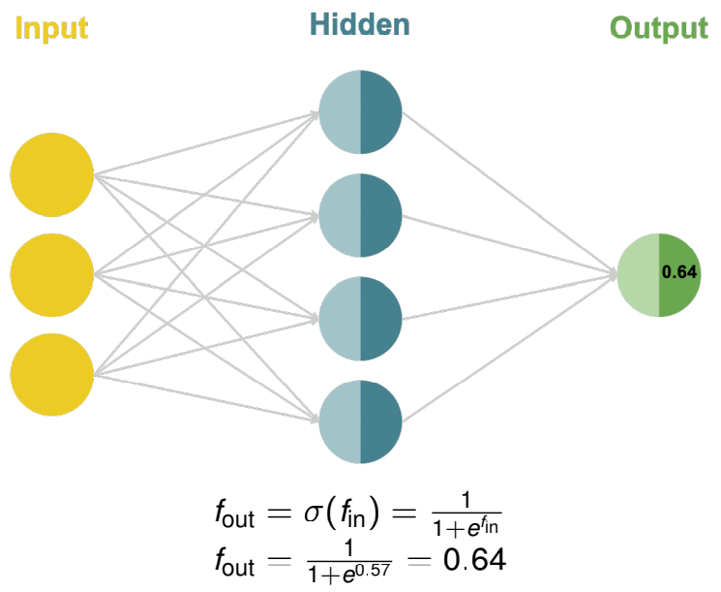
Fully-Connected Neural Networks: Forward Pass
Each neuron in the hidden layer performs an affine transformation on the inputs:
Each hidden neuron performs a non-linear activation transformation on the weighted sum:
The output neuron performs an affine transformation on its inputs:
The output neuron performs a non-linear activation transformation on the weighted sum:

Slide 25
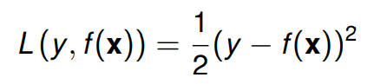
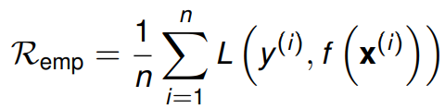
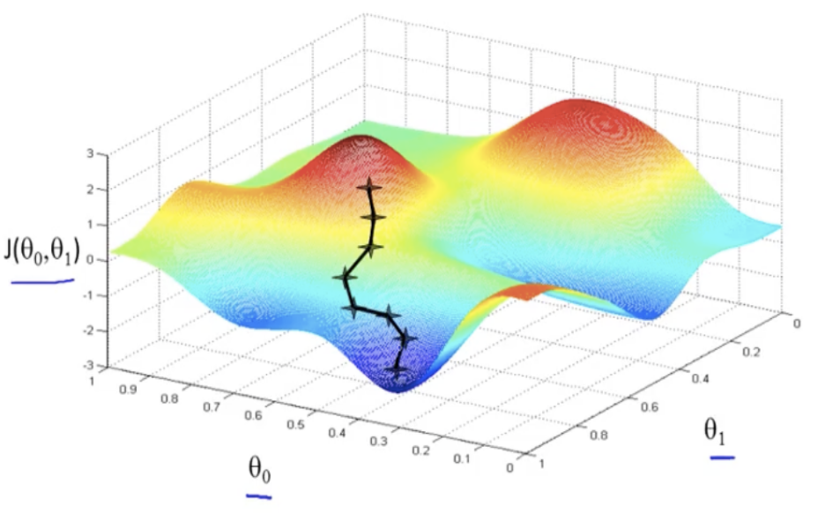
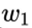
Neural Network Training
Key question: how to pick the parameters w so that the mathematical function f(x) that the neural network represents is a useful mapping between inputs and outputs?
Answer: function optimization based on data
Introduce a loss function L (y, f(x)) that compares the network’s predictions f(x) to the ground truth y.
For regression, we typically use the L2 loss (rarely L1):
For binary classification, we typically apply the cross entropy loss (also known as bernoulli loss):
We minimize the sum of this loss function across our data points -> empirical risk minimization
This minimization is done with iterative algorithms like gradient descent

Slide 26
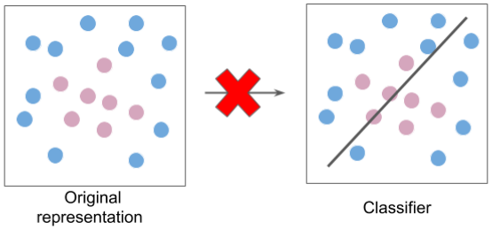
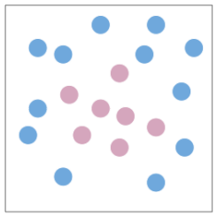
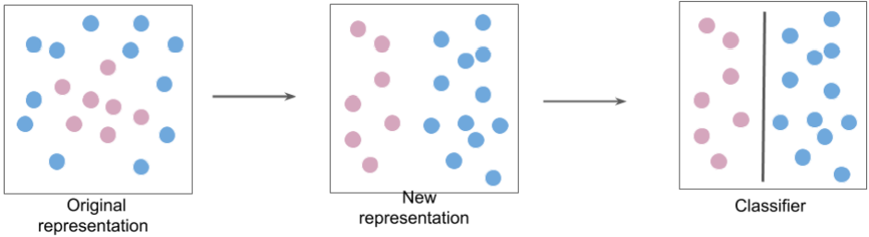
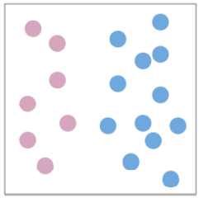
Neural Network Motivation
Individual neurons are used as building blocks to build more complicated mathematical functions. This allows us to define the “right” kinds of hypothesis spaces to learn functions that are more common in our universe in a data-efficient way (s. Lin, Tegmark et al. 2016).
1) A single neuron is restricted to learning only linear decision boundaries. Thus, its performance on the following dataset is quite poor:
2) However, the neuron can easily separate the classes if the original features are transformed (e.g. from Cartesian to polar coordinates):
3) Instead of classifying the data in the original representation:
4) We classify it in a new feature space:

Slide 27
Representation Learning
It is critical to feed a classifier the “right” features in order for it to perform well.
Before deep learning took off, features for tasks like machine vision and speech recognition were “hand-designed” by domain experts. This step of the machine learning pipeline is called feature engineering.
The single biggest reason DL is so important is that it automates feature engineering. This is called representation learning.

Slide 28
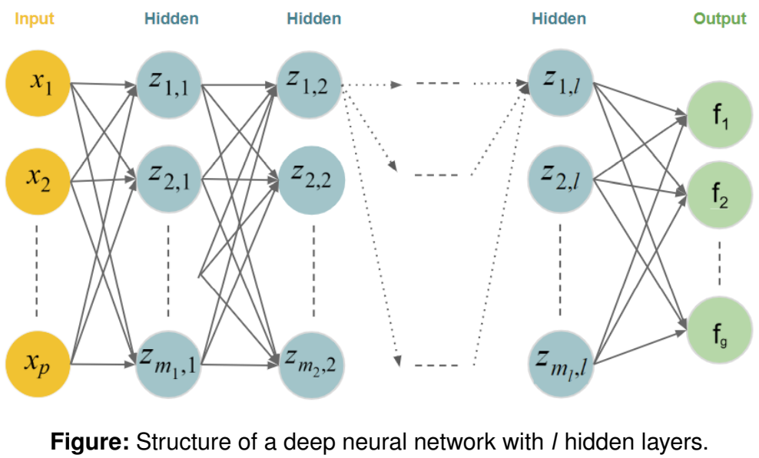
Deep Fully-Connected Neural Networks
Why deep networks?
Multiple layers allow for the (efficient) extraction of more and more abstract representations. Each layer adds non-linearity to the model
Neural networks today can have hundreds of hidden layers. Historically, the training of such networks was challenging but it was made possible through various advances
New activation functions (ReLU) that solved a problem known as “vanishing gradients”
New hardware that cut down training time (GPUs)
Order of magnitudes more data which benefits from the capacity of deep neural networks to learn complex functions (when dataset sizes are small, other models (such as SVMs) and techniques (such as feature engineering) often outperform (deep) neural networks
Novel architectures that are capable of handling complex (unstructured) data → e.g. CNNs for image data
Better optimization and regularization methods
State-of-the-art neural networks are much more sophisticated than the simple architectures described here (needless to say)

Slide 29
Applications of Deep Learning: Text
Deep learning is a subfield of Machine Learning based on artificial neural networks.
The top-performing models in many domains at the moment are deep-learning-based models, e.g. in NLP (GPT-3, BERT), Computer Vision (),
Deep learning is the field that is the closest to general artificial intelligence that we have at this point in time (although arguably we are still far away from general artificial intelligence)

Slide 30
Applications of Deep Learning: Speech
Deep learning is a subfield of Machine Learning based on artificial neural networks.
The top-performing models in many domains at the moment are deep-learning-based models, e.g. in NLP (GPT-3, BERT), Computer Vision (),
Deep learning is the field that is the closest to general artificial intelligence that we have at this point in time (although arguably we are still far away from general artificial intelligence)

Slide 31
Fully-Connected Neural Networks
Deep learning is a subfield of Machine Learning based on artificial neural networks.
The top-performing models in many domains at the moment are deep-learning-based models, e.g. in NLP (GPT-3, BERT), Computer Vision (),
Deep learning is the field that is the closest to general artificial intelligence that we have at this point in time (although arguably we are still far away from general artificial intelligence)

Slide 32
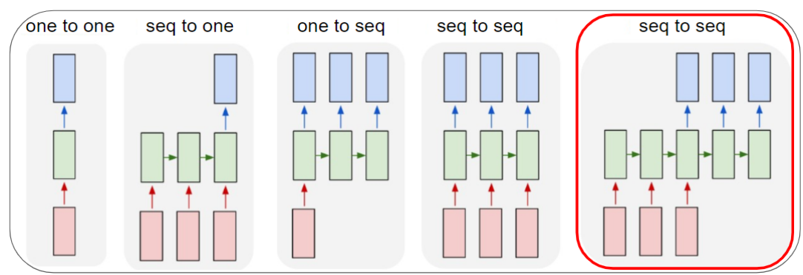
Sequence to Sequence Tasks

Slide 33

Transformers
“Novel” dominating deep learning architecture. Originally designed for sequence-to-sequence tasks (in particular machine translation)
Transformer: Vaswani, A. et al. Attention Is All You Need. arXiv [cs.CL] (2017)
Large-scale state-of-the-art NLP models were possible thanks to Transformers and self-attention combined with transfer learning and unsupervised pre-training
BERT: Devlin, J., Chang, M.-W., Lee, K. & Toutanova, K. BERT: Pre-training of Deep Bidirectional Transformers for Language Understanding. arXiv [cs.CL] (2018)
GPT-2: Radford, A. et al. Language models are unsupervised multitask learners. OpenAI blog 1, 9 (2019)
GPT-3: Brown, T. et al. Language Models are Few-Shot Learners. Adv. Neural Inf. Process. Syst. 33, 1877–1901 (2020)
RoBERTa: Liu, Y. et al. RoBERTa: A robustly optimized BERT pretraining approach. arXiv [cs.CL] (2019)
Top-1 resource hub for transformers & NLP: Huggingface Transformers
https://huggingface.co/docs/transformers/index

Slide 34
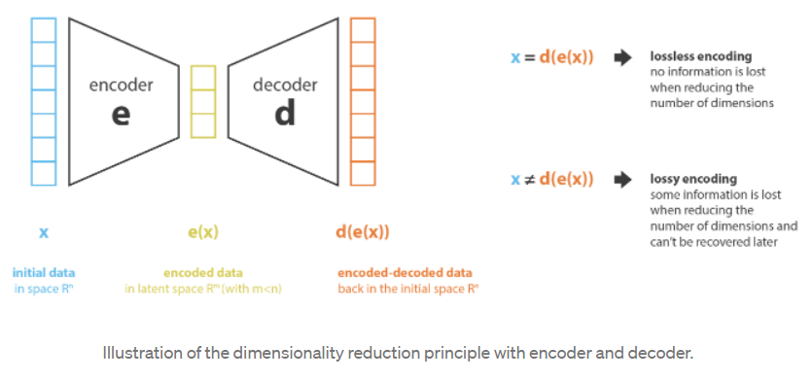
Autoencoders

Slide 35
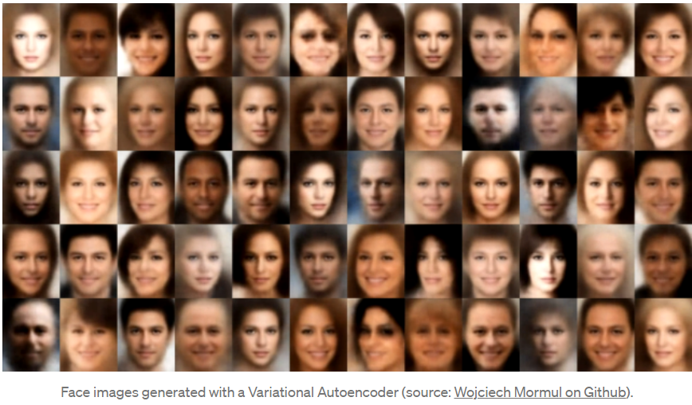
Deep Generative Models
Variational Autoencoders (VAEs)
Generative Adversarial Networks (GANs)
Produce highly realistic pieces of content of various kind, such as images, texts and sounds
Understanding Variational Autoencoders (VAEs) | by Joseph Rocca | Towards Data Science
In a nutshell, a VAE is an autoencoder whose encodings distribution is regularised during the training in order to ensure that its latent space has good properties allowing us to generate some new data.

Slide 36
Transformers
“Novel” dominating deep learning architecture. Originally designed for sequence-to-sequence tasks (in particular machine translation)
Transformer: Vaswani, A. et al. Attention Is All You Need. arXiv [cs.CL] (2017)
Large-scale state-of-the-art NLP models were possible thanks to Transformers and self-attention combined with transfer learning and unsupervised pre-training
BERT: Devlin, J., Chang, M.-W., Lee, K. & Toutanova, K. BERT: Pre-training of Deep Bidirectional Transformers for Language Understanding. arXiv [cs.CL] (2018)
GPT-2: Radford, A. et al. Language models are unsupervised multitask learners. OpenAI blog 1, 9 (2019)
GPT-3: Brown, T. et al. Language Models are Few-Shot Learners. Adv. Neural Inf. Process. Syst. 33, 1877–1901 (2020)
RoBERTa: Liu, Y. et al. RoBERTa: A robustly optimized BERT pretraining approach. arXiv [cs.CL] (2019)
Top-1 resource hub for transformers & NLP: Huggingface Transformers
https://huggingface.co/docs/transformers/index

Slide 37
Awesome Resources to Master Deep Learning
Coursera Deep Learning Specialization by deeplearning.ai / Andrew Ng
Covers neural networks & deep learning fundamentals, hyperparameter tuning, regularization & optimization, how to structure ML projects, convolutional neural networks and sequence models
Deep Learning Course at the Center for Data Science NYU by Yann LeCun (one of the deep learning goodfathers)
Deep Learning MIT book by Ian Goodfellow (among other things the creator of Generative Adversarial Networks) and Yoshua Bengio (another deep learning goodfather)
Paid O’Reilly hands-on ML book by Aurélien Géron

Slide 38
Deep Learning Resources
Deeplearning.ai Deep Learning Specialization
Fast.ai Practical Deep Learning for Coders Course
Yann LeCun’s Deep Learning Course
Ian Goodfellow’s Deep Learning Book
Notes:
Clusters are set up, configured, and fine-tuned to ensure reliability and performance without the need for monitoring.

Slide 39
Deep Learning Lab
Deep Learning with PyTorch & Hugging Face Transformers

